Slide 1
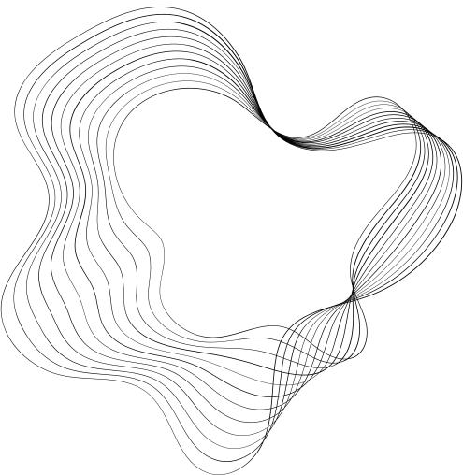

FULL STACK
PLATFORM
FOR ENGINEERING FACULTY

Slide 2

ABOUT US
Project executor :
Ahmed elkharashy
Project supervisor :
Dr. Ahmed Salem

Slide 3

TECH STACK
UI/UX :
The user interface is designed to be sijmple and user friendly which gives better user exprience
Back-end :
For server-side i’ve used nodeJs and mysql as a core ,I used express as a framework which provides me with the power to create a strong powerfull and scalable app
Front-end :
For client-side I used basic front-end technologies like Html5,css,js and bootstrap

Slide 4
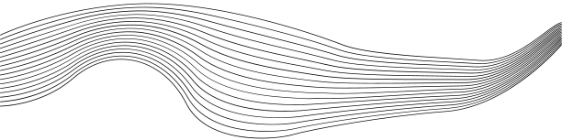
Designg patterns
I used MVC - which stands for Model View Controller- design pattern
as acore design pattern for my project ,due to its efficiancy and reliablity
Others
I also have used so many node modules and iam going to mention some of them
nodemon
upload
express-session
body-parser
express-router
express-session

Slide 5

BENEFITS OF THE PROJECT
Usability
Interactive Learning
Scalabilty
This web platform can be used as in production platfom due to hiegh perfomance and security
This platform supports multimedia content which give it flexiblity and vareity of content
can accommodate large numbers of users simultaneously, making them scalable and suitable
ENVIRONMENT FRIENDLY :
E-learning plays a significant role in preserving the environment by reducing paper consumption.

Slide 6

THANK'S FOR WATCHING

